Slide 1


Slide 2
Enabling
open digital workflows
An Introduction to
buildingSMART International
Richard Petrie Chief Executive
October 2018
Notes:
OpenBIM is the initiative of buildingSMART and several leading software vendors and looks at the issues going forward as we head towards BIM Level 3 using the open buildingSMART Data Model
We look at the universal approach of creating a transparent and open workflow and industry standard for collaboration
Using a common language for referenced processes allowing Government and industry to procure with transparency and assured data quality
Looking at the entire asset life cycle and avoidance of multiple data input
Creating a platform were small and large platform vendors can participate and compete
Ensuring the supply chain is driven by demand but delivers product data directly into BIM

Slide 3

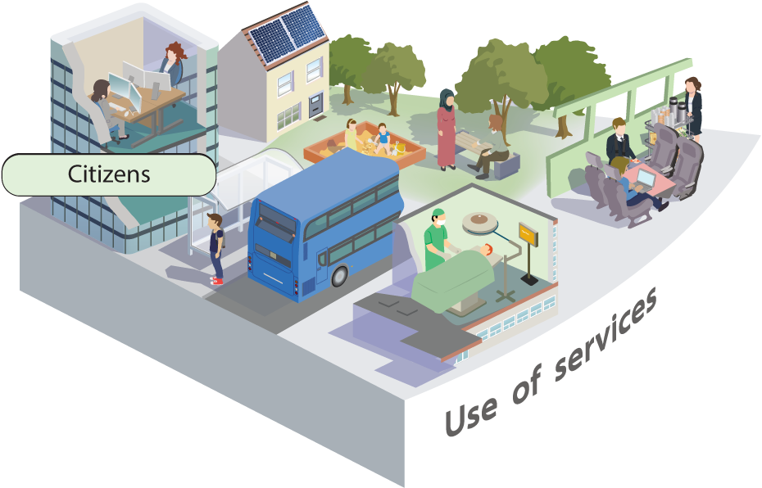


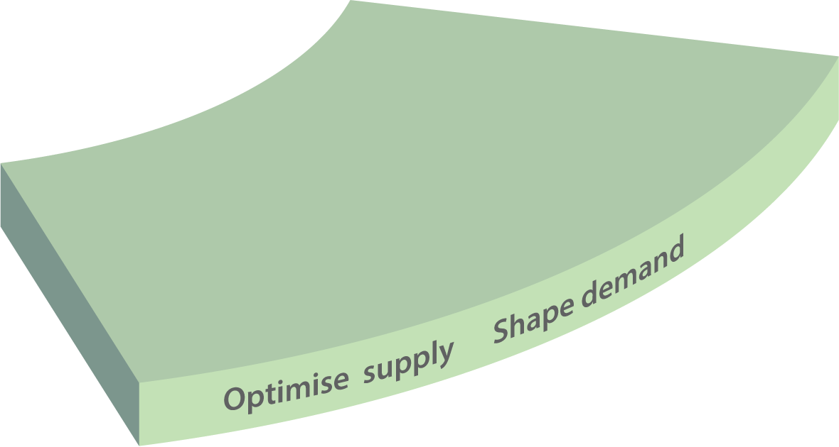
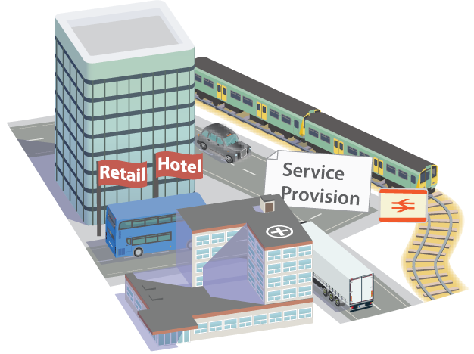





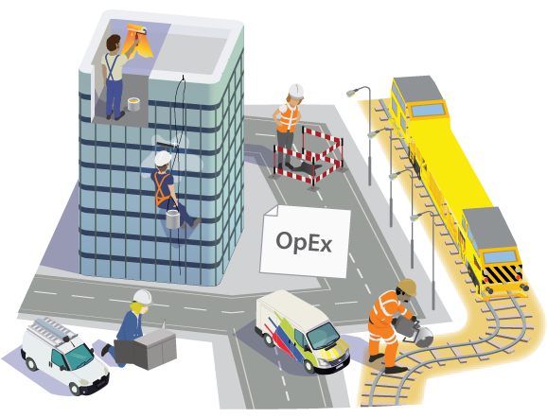


Digitizing built assets
Flow of
information
Accredited to Digitally Built Britain
Notes:
buildingSMART wants to enable a clear line of sight across the asset lifecycle, so that at each phase the information is available to make the correct decisions about cost, performance and risk.
This slide is borrowed from Digital Built Britain and illustrates our intention of delivering both the information feed-forward and information feed-back loops in secured, interoperable, shared data formats.

Slide 4
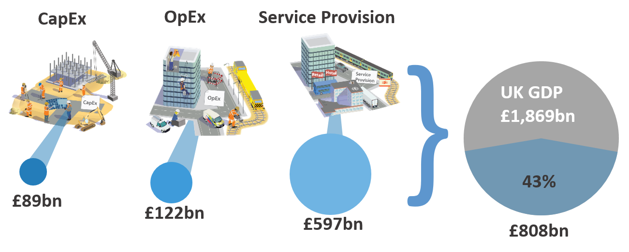
Benefits of openBIM
UK Government seeks productivity improvements
Accredited to Digitally Built Britain
Notes:
This slide is also borrowed from Digital Built Britain because it offers some clear metrics about the size of the benefits to be achieved.
The gains are realised in the Capital Expenditure phase of projects are the most visible but actually are the smallest part of the overall benefit.
The majority of economic value associated with the Built Environment occurs during the rest of the economic life of an asset, as it moves through the stages of maintenance and operation, service provision and service use.
Trusted information from the CapEx phase is required for efficient and safe operation and maintenance of built assets in the OpEx Maintain/Operate phase.
Interoperable information is required beyond the OpEx phase as optimisation in service provision and strategic investment planning is usually dependent upon information from multiple infrastructure systems, covering variable sizes of geographic areas from communities, to cities, regions, and ultimately a whole country.
Information captured from infrastructure operations, service delivery patterns and the use of the services by citizens can be fed back to create a virtuous cycle, improving future designs, fine-tuning operations and optimising service delivery design to meet the changing needs of citizens.

Slide 5










openBIM Proponents
(2)
(1)
(1) An Action Plan to Accelerate Building Information Modeling (BIM) Adoption – Feb 2018
(2) Handbook for the introduction of Building Information Modelling by the European Public Sector
Notes:
Note 1: Quote: ‘What the industry needs is “big and open” BIM, which integrates the entire value chain and is characterized by full interoperability of software and open access to it.’

Slide 6
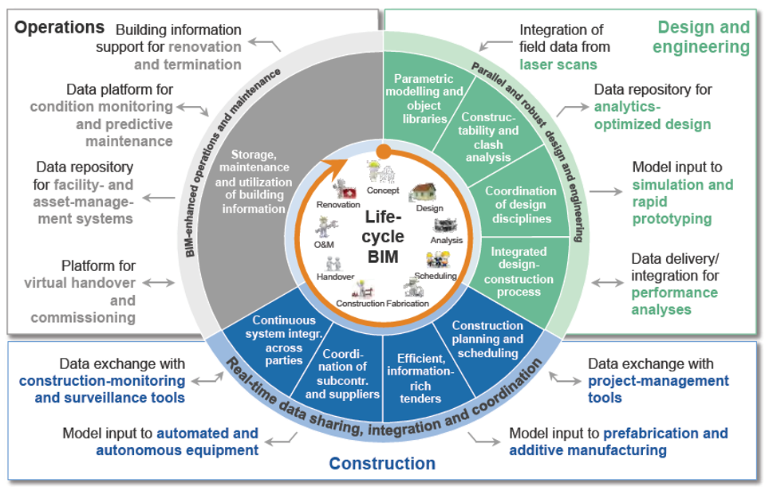
openBIM The Future
Application of BIM
Source Boston Consulting Group and WEF

Slide 7
buildingSMART

Slide 8
buildingSMART
Vision
Enable full benefits
from
digital ways of working
in the
built asset industry

Slide 9
buildingSMART
Values
  Open
  Neutral
  Non-Profit
  International

Slide 10
buildingSMART
Link Four Key Processes
Design
Procure
Operate
Assemble

Slide 11
buildingSMART
Goals
  openBIM Solutions
  openBIM Standards
  openBIM Adoption
  openBIM Use
  openBIM Compliance

Slide 12
buildingSMART
History
  1995 Established
  2000 IFC2
  2001 IFD ISO
  2012 IFC4 + bSDD
  2013 IFC ISO
  2014 IFC Infrastructure
  2015 BCF
2016 Enabling workflows

Slide 13






Working with others

Slide 14
World Economic Forum
An action plan to accelerate BIM adoption – Feb 2018
“IU companies should support similar bottom-up consortia to standardize BIM data exchange …One such consortium exists – buildingSMART, which developed the Industry Foundation Class (IFC), the only open (non-proprietary) BIM data exchange standard – but more needs to be done.”
IU = Infrastructure and Urban Development Industry

Slide 15







Members
Strategic Members

Slide 16







Members
Multinational Members

Slide 17























Members
Standard Members

Slide 18
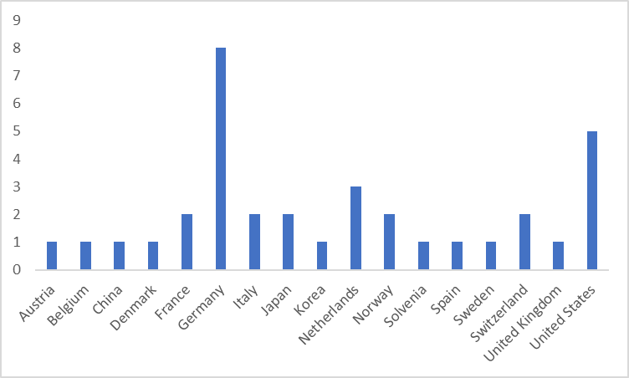
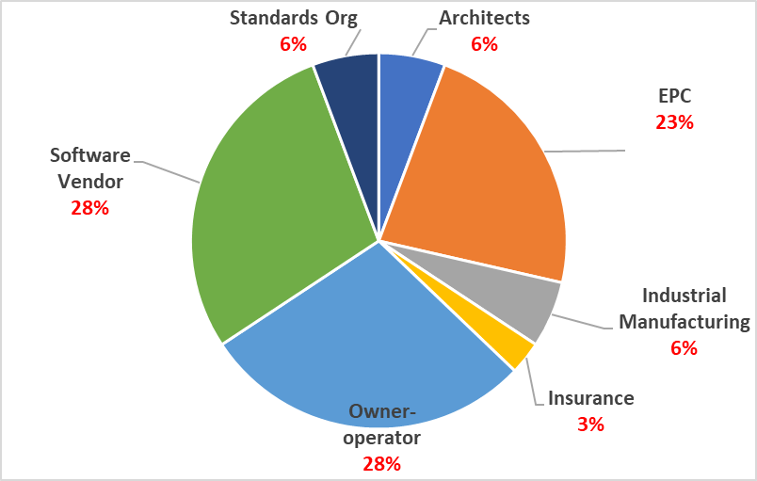

buildingSMART
International Organizational Membership
Members by country
Members by type

Slide 19


















Chapters
Notes:
Chapters are national or pan-national (regional) entities
Chapters lead and promote the active use of openBIM in their country
Chapters are
Not for profits, neutral and independent organization
Aligned to the Vision and Mission of buildingSMART International
Part of the broader buildingSMART movement promoting our objectives
Not be used as a marketing agency for private or personal interests!
The first responsibility of a Chapter is to provide in-country leadership for open digital solution development:
Engage industry and government
Create local forums to:
Assist users with open digital solutions
Create consensus on new solution requirements

Slide 20
buildingSMART
Community
Membership benefits
Become a part of the international home of openBIM
Access to the growing bSI community
Opportunity to collaborate with owner-operators, software vendors, infrastructure providers, EPC’s and product manufacturers.
Develop your own digital strategy with bSI open standards
Federate your information
Develop new market opportunities
Contribute to a well-known brand
Learn from experts around the globe
Promote your company
Deliver more for your end clients
Join the fast growing BIM Community

Slide 21
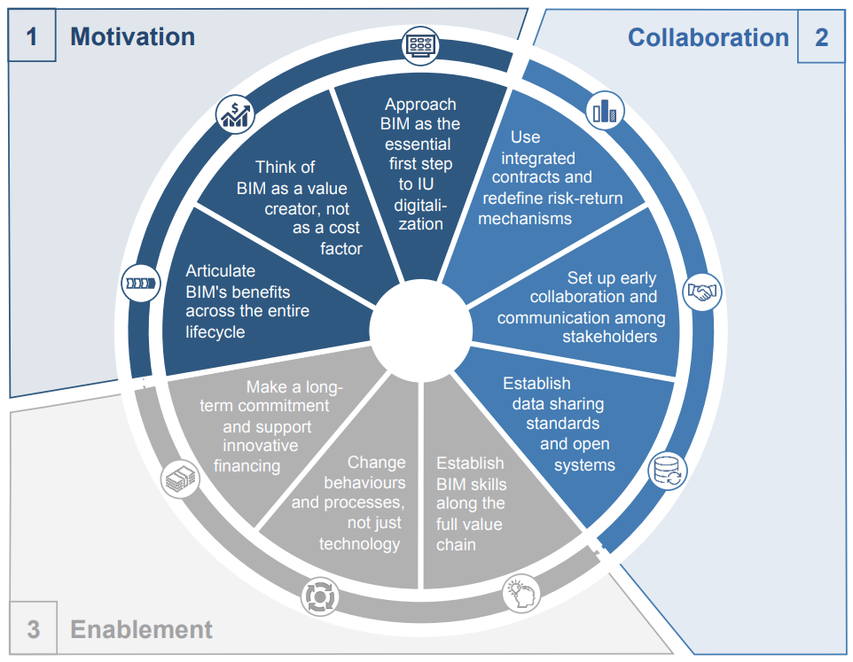
Our Programs
WEF BIM Adoption Cycle
buildingSMART
User Program
buildingSMART
Standards Program
buildingSMART
Compliance Program
WEF: An action plan to accelerate BIM adoption – Feb 2018

Slide 22


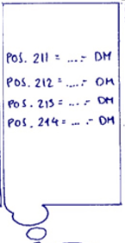
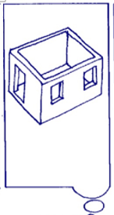
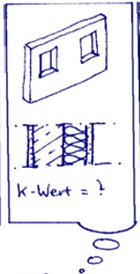

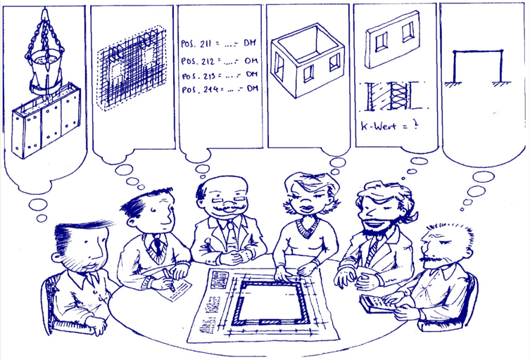
Digitising workflows
Process Descriptions
Exchange Requirements
Data
Structure
View
View
View
View
Purpose –driven workflows
Workflow Concept by
Professor Rasso Steinmann. IABI
Notes:
bSI’s output is essentially to allow the requirements, of all the people involved in an asset’s life, to be communicated to each other easily. Different professional disciplines have different requirements.
These requirements are exchanged using open digital workflows.
The data structure container is called an IFC Schema but there is no need for most people to be concerned with that. They just have to know that it exists, similar to knowing that the operating system on a mobile telephone exists.
The views, you might think of them as ‘apps’ that people use to access the data are known as MVDs (model view definitions)
In fact there are five basic standard types in the buildingSMART portfolio that perform different functions. These are described on the next page. They exist to give all actors in an assets life the ability to make decisions about cost, performance and risk at every phase of the life cycle.
The IFC suite of standards is more fully explained here: http://buildingsmart.org/ifc/ and here: http://buildingsmart.org/standards/technical-vision/

Slide 23


Enabling digital ways of working
Computer
Exchange Requirements
Exchange Requirements
Five Basics for Sharing our Thoughts:
1. Process Descriptions IDM
2. Enabling Data Structure IFC
3. Change coordination BCF
4. Defined terms and types bSDD
5. Digital Workflows MVD
BIM
Apps
Workflow Concept by
Professor Rasso Steinmann. IABI
Notes:
The buildingSMART Family of Standards are:
IDM Information Delivery Manual - ISO 29481-1 ISO 29481-2
Looks at individual processes and maps them to understand what should be flowing and when
IFC Industry Foundation Classes - ISO 16739
The basic ‘operating system’ that transports the information and the data.
BCF BIM Collaboration Format
Provides the ability for change management through issue tracking and allows a fully managed cycle.
IFD International Framework for Dictionaries - ISO 12006-3
Includes the bSDD buildingSMART Data Dictionary. Collects the terms, vocabulary and attributes for things
MVD Model View Definition
Translates the processes into technical requirements. A subset of the larger IFC model for a particular purpose or use. The bits that ‘Users’ tend to see.

Slide 24










Digital continuity requires standards
Heterogeneous solutions, multiple partners,… on a shared project
An agreement between bSI and UIC will ensure interoperability between IFC Rail and RailTopoModel
Construction
Civil Eng.
Project Mngr
Client
Maintenance
Catenary
Digital Twin
Maintainer
Design
Signaling
Track
GIS
Operator
Geologist
Economist
Requirements
Operation
The Digital Twin requires standards for digital continuity

Slide 25






Project Case Study
“IFC RAIL”
Mission: To set global open and interoperable BIM standards for the rail industry by extending the IFC schema to create the “IFC Rail Candidate Standard”
Timeline: April 2018 – March 2019.
International collaboration: 4 bSI Summits and 8 expert panel meetings for project participants
Resources:
Project leaders and project team
Expert panel
InfraRoom Administrator
24 team members (plus 70+ in-kind contributors)
Funding raised: €2,500,000 +/-

Slide 26
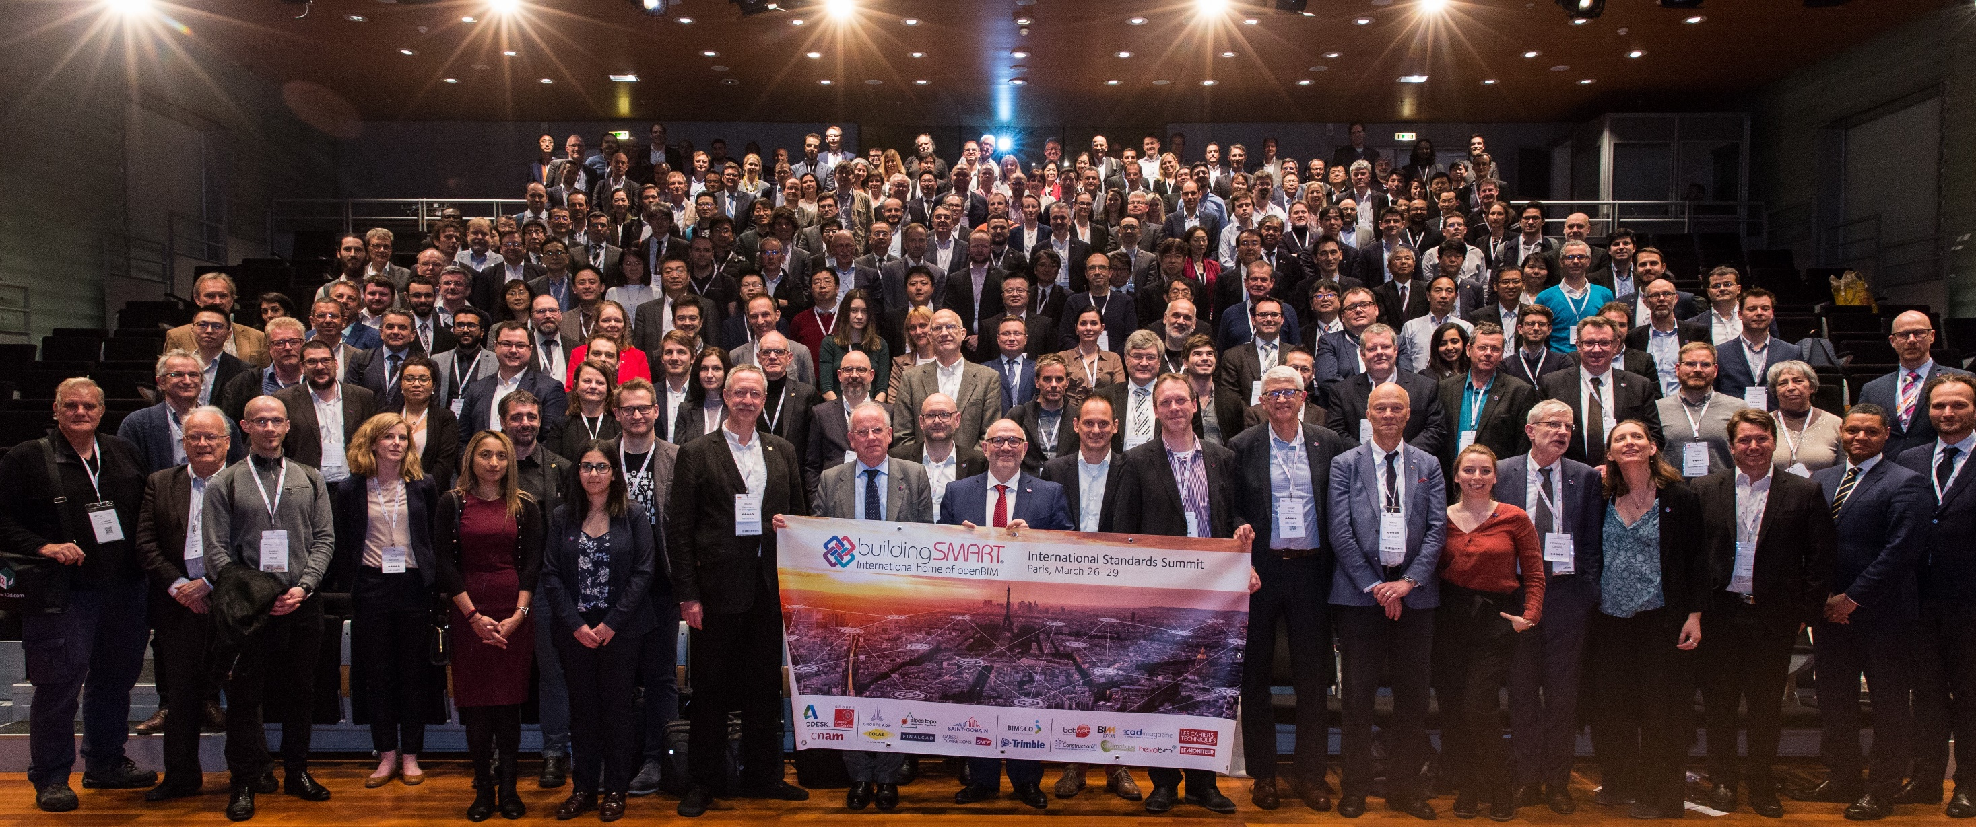
buildingSMART Summits
Paris Summit 2018
400 People from 38 Nations & 225 organisations
Strong Industry and Government Representation

Slide 27
Published
bSI Final Standards bSI Final Technical Report
IFC Base Standards ISO
IFC Specifications & Tools
IFC 4 Specialist site
IFD Framework for object orientated info ISO
IFC4 Design Transfer view MVD
IFC4 Reference view MVD
IFC4 Infrastructure Alignment
BIM Collaboration Format XML
BIM Collaboration Format API
BIM Collaboration Format v 2.1
IFC 4.1 Alignment positioning
Model View Definition for LANDXML v1.2
Infrastructure Overall Architecture
Open Standards for Regulation
Infrastructure Asset Management
buildingSMART SPE
IFC Rail bSI SPEC
IFC Road bSI SPEC

Slide 28
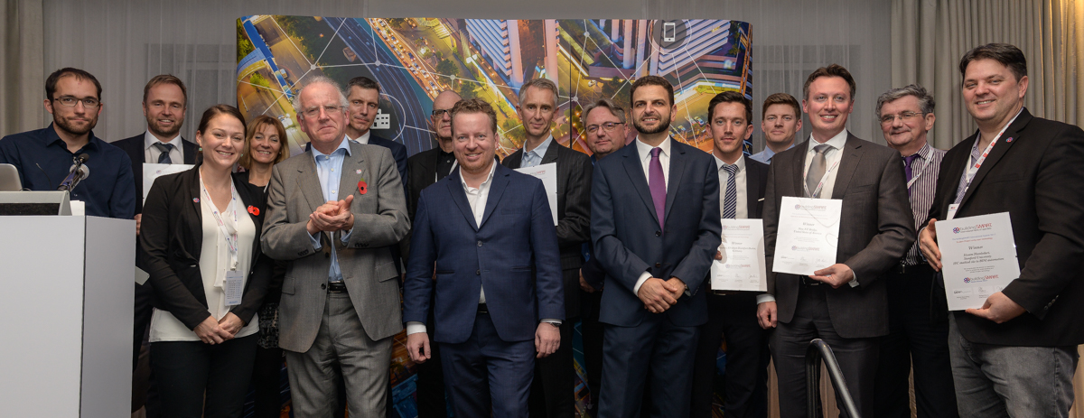


International Awards - 2018
Susan Keenliside
House of Commons Canada
Real Property Directorate
buildingSMART International User Group
Open for submissions: 26 March
Deadline for submissions: 31 July
Awards ceremony: 16 October - Tokyo

Slide 29


Professional Certification and Individual Qualification

Slide 30
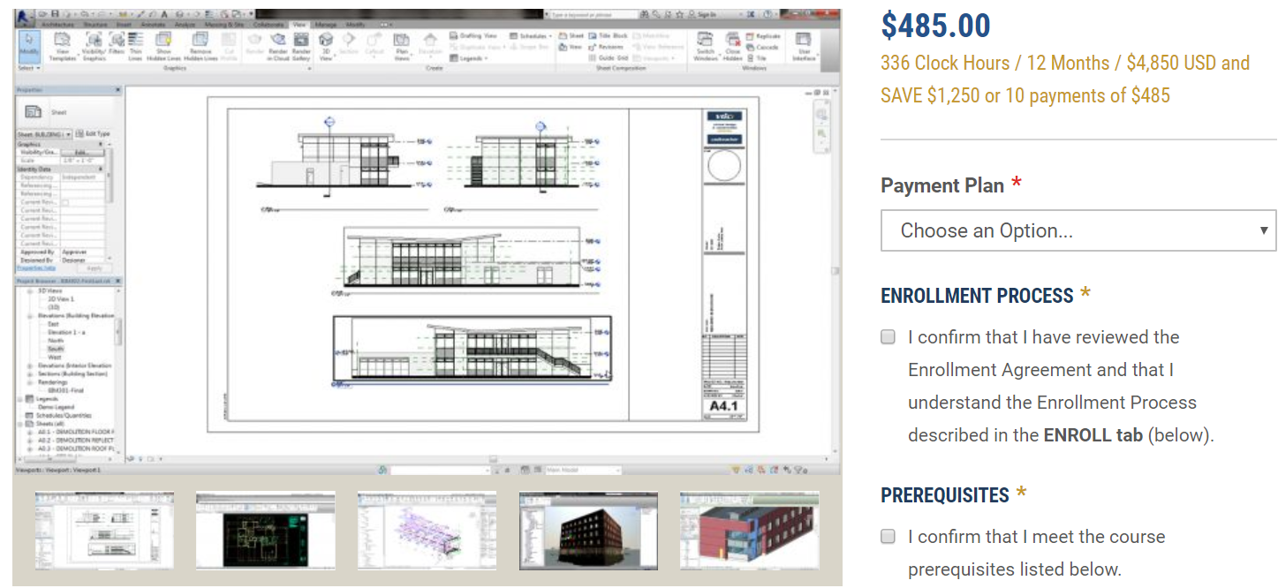
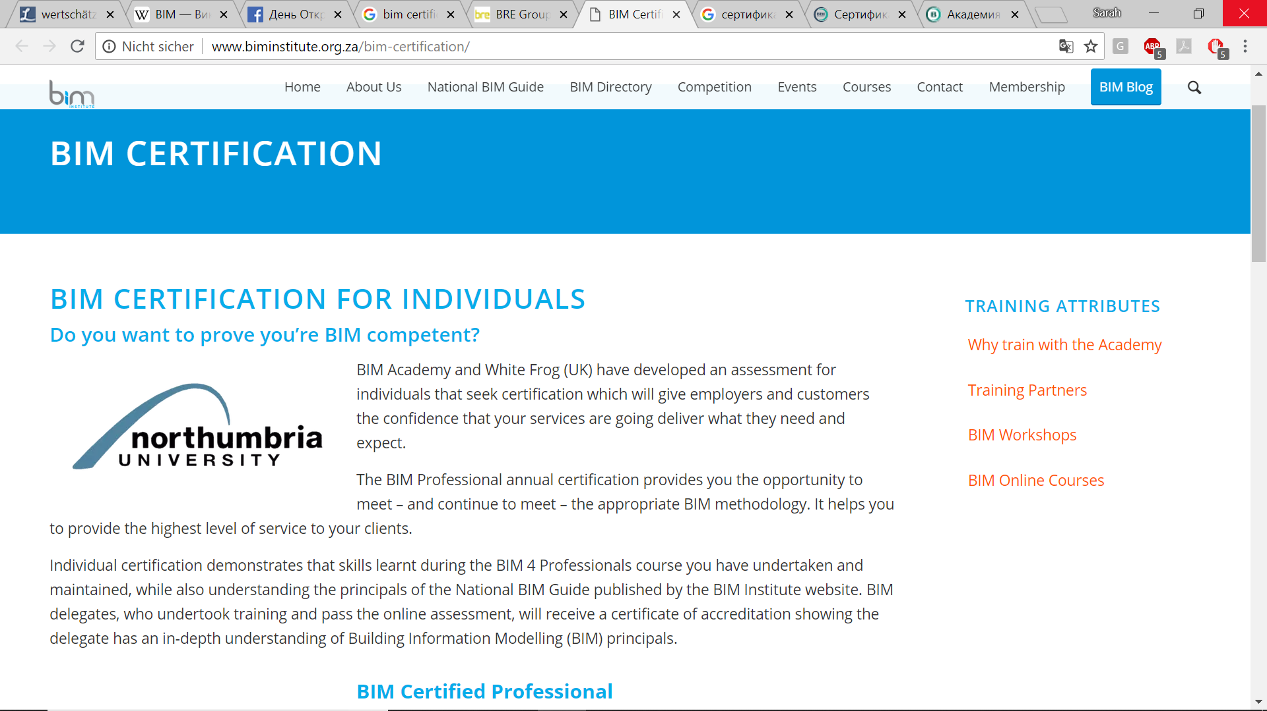
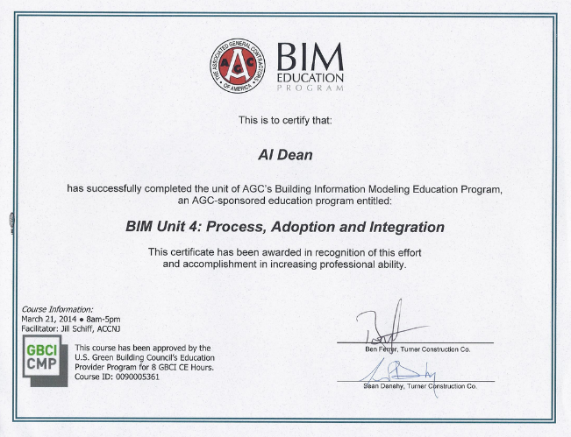
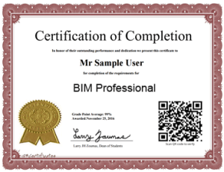
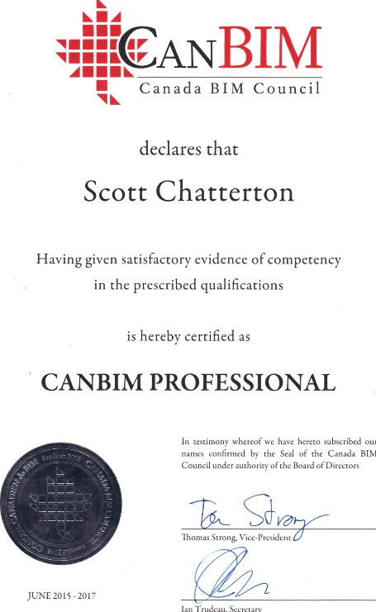
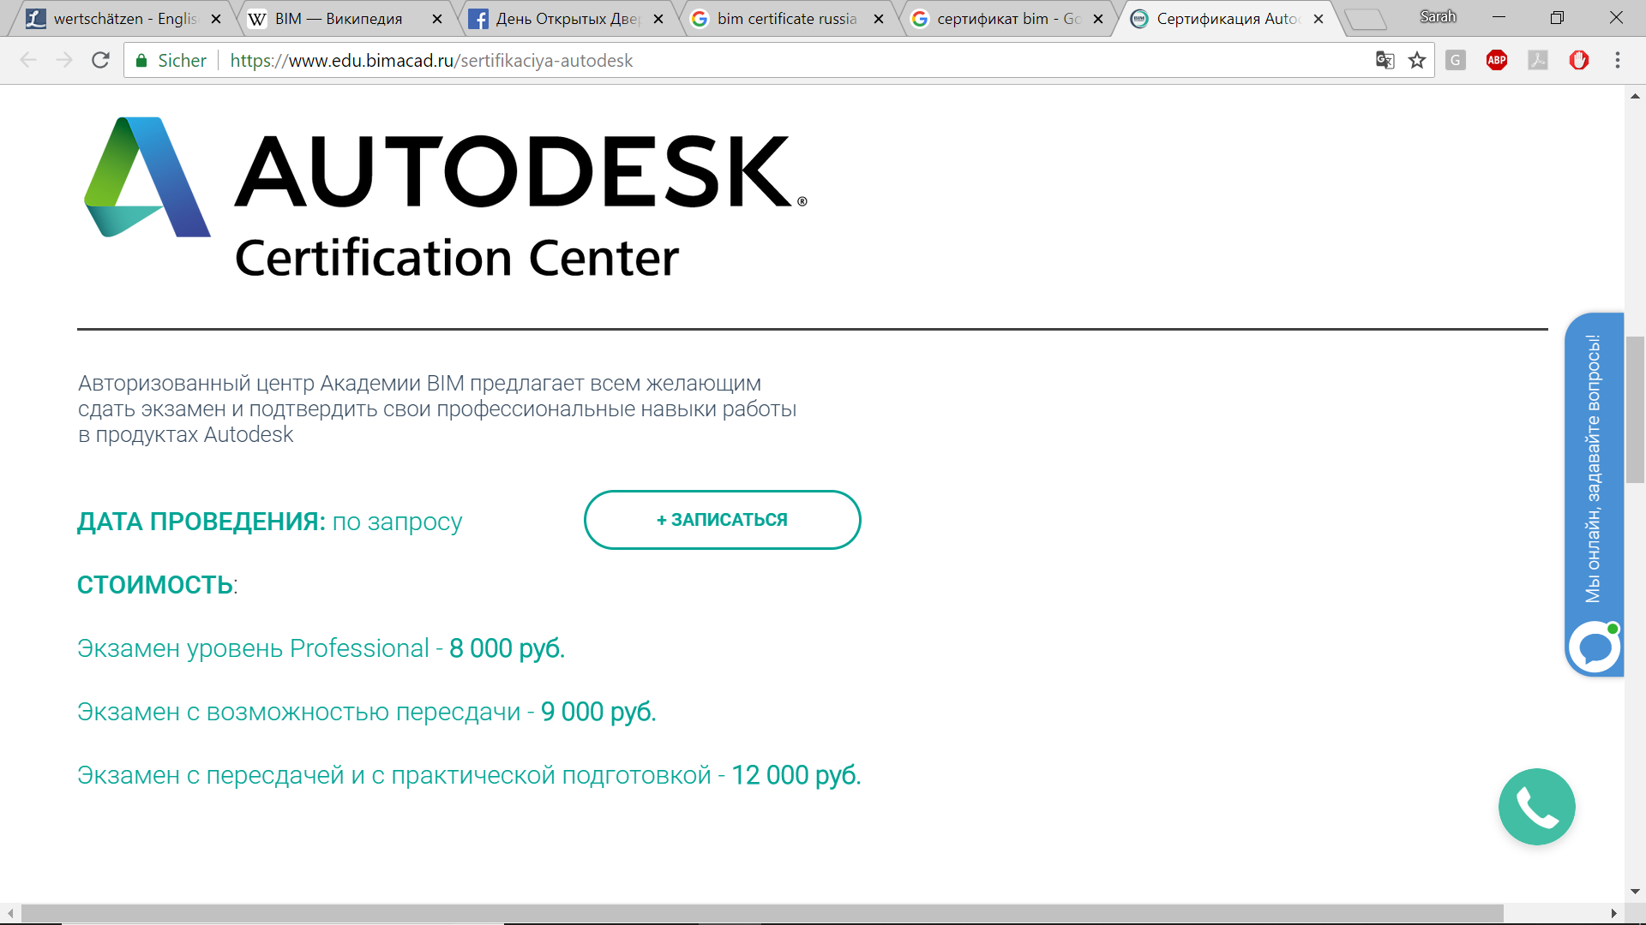
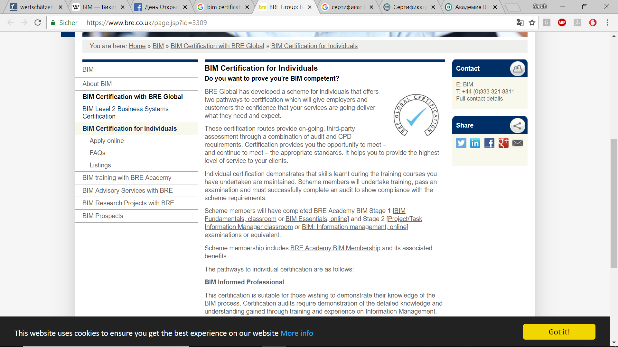
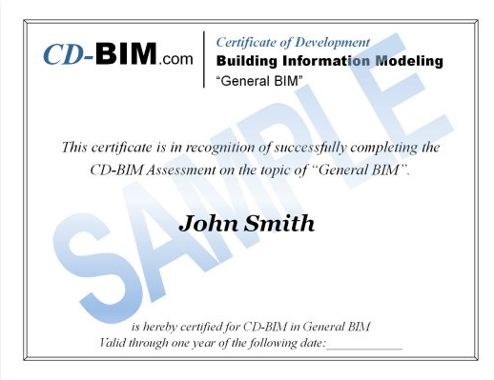
INTERNATIONAL STANDARDIZATION
Certification Confusion
Notes:
We‘ve seen requirements of authorities and ministries in the use of BIM, private owners as well. But how to prove?

Slide 31
CHALLENGE
Complex Method – Complex User Group
Owner
Architect
Structural Engineer
MEP-Engineer
Facility Manager
Contractor
BIM
Craftsmen
Supplier
Authorities
Manufacturer
Notes:
And how can there be one certificate for every one?
Building Information Modeling is a method, which concerns everyone along the value chain of planning, constructing and operating – if not today, then in near future!
But for this work process, for this collaboration with so many different disciplines we need two important things – openness and words.
And the second: words. For an expedient collaboration with so many disciplines we need a common language. , so that project partners are able to communicate with each other, to describe and fulfil BIM-specific requirements across disciplines, construction phases and softwares –
This is bringing us back to certification – we can achieve a certificate by finding the common language, a common knowledge base.
Overview, common language, common lauguage that actors can trust – quality benchmark.

Slide 32
INTERNATIONAL STANDARDIZATION
Do we need an international BIM Certification?
Notes:
Survey of bS Community and Chapters

Slide 33
INTERNATIONAL STANDARDIZATION
Why Professional Certification?
Requirements on international standardization regarding:
Consistent understanding of BIM (terminology and processes)
Verifiable qualified BIM professionals with comparable competence level
Global benchmark for content of teaching and certification standards
Notes:
Denn wir müssen beachten: In den letzten Jahren konnten wir auf der ganzen Welt eine beschleunigte Adoption von BIM beobachten. Allerdings gibt es noch viel Verwirrung und fehlende Konsistenz bei der Definition von Prozessen und bei der Verständigung über Grundbegriffe und Konzepte. Es gibt auch eine große Unterschiede in der Kompetenz der Mitarbeiter, die BIM-Projekte bearbeiten und managen. Damit die BIM-Adaption weltweit erfolgreich gelingt, brauchen wir also auch einen internationalen Konsens bei der Anwendung von standardisierten Begriffen und Prozessen und ein Benchmarking-System, anhand dessen die Kompetenz von Einzelpersonen bewertet werden können – und das, wenn man an große internationale Projekte denkt, bestenfalls weltweit.

Slide 34
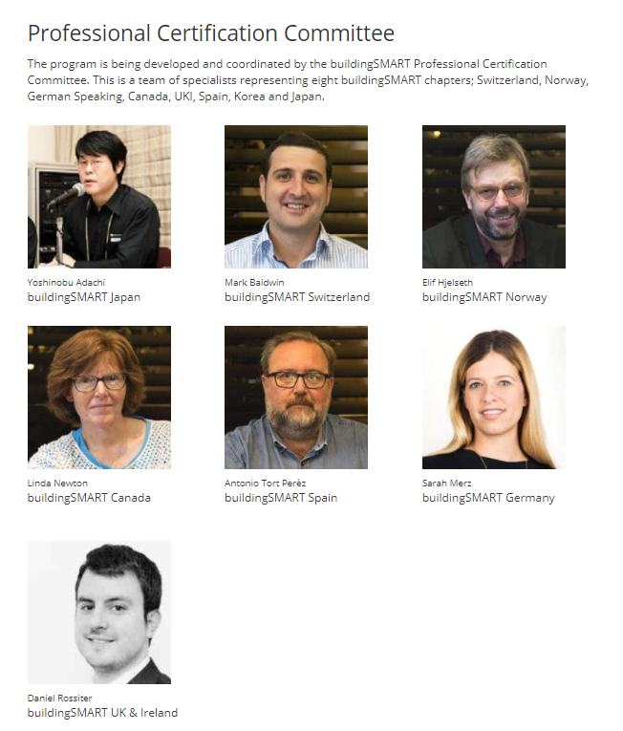
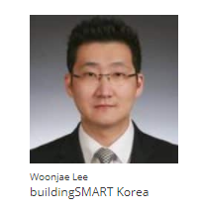
INTERNATIONAL STANDARDIZATION
Professional Certification Program
Certification Program of buildingSMART International
Development and coordination by international committee
NOR
CAN
UKI
JPN
GER
KOR
SUI
ES
Notes:
Während also bei VDI die Richtlinie zur Definition notwendiger und allgemeiner BIM-Kenntnisse entwickelt wurde, geschah selbiges auf internationaler Ebene. Hierfür fanden sich schließlich Experten aus acht Ländern zusammen.

Slide 35
INTERNATIONAL STANDARDIZATION
Scope of Work buildingSMART International
Program initiator and point of contact for national chapters
Development of minimum requirements on teaching content
Standardization and dissemination of openBIM Certifications
Development of a testing tool for personal certification
Notes:
Lowest common denominator

Slide 36
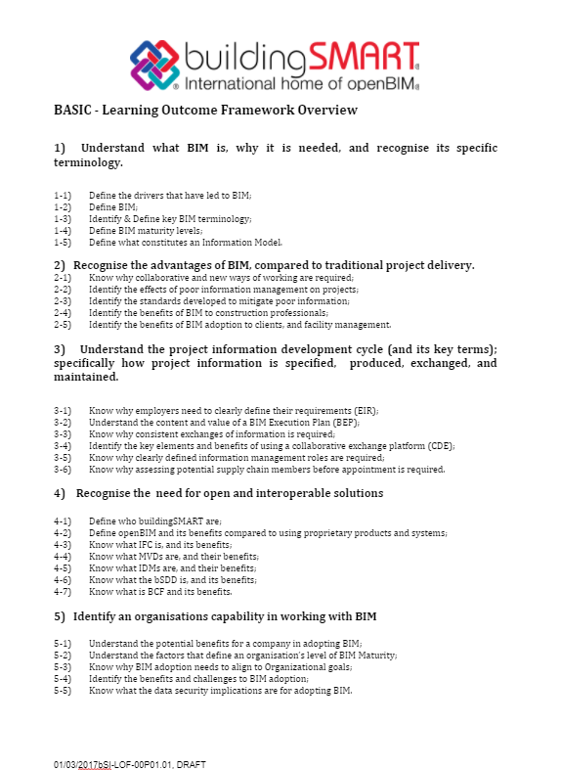
INTERNATIONAL STANDARDIZATION
Who is the program aimed at?
• Individuals
• Industry organizations
• Training organizations
• buildingSMART chapters
Notes:
Lowest common denominator

Slide 37
INTERNATIONAL STANDARDIZATION
Learning Outcome Framework
1) Understand what BIM is, why it is needed and recognize its specific terminology.
2) Recognize the advantages of BIM, compared to traditional project delivery.
3) Understand the project information development cycle (and its key terms); specifically how
project information is specified, produced, exchanged and maintained.
4) Recognize the need for open and interoperable solutions.
5) Identify an organizations capability in working with BIM.
Notes:
Base
19 Chapter von buildingSMART in 26 Ländern

Slide 38

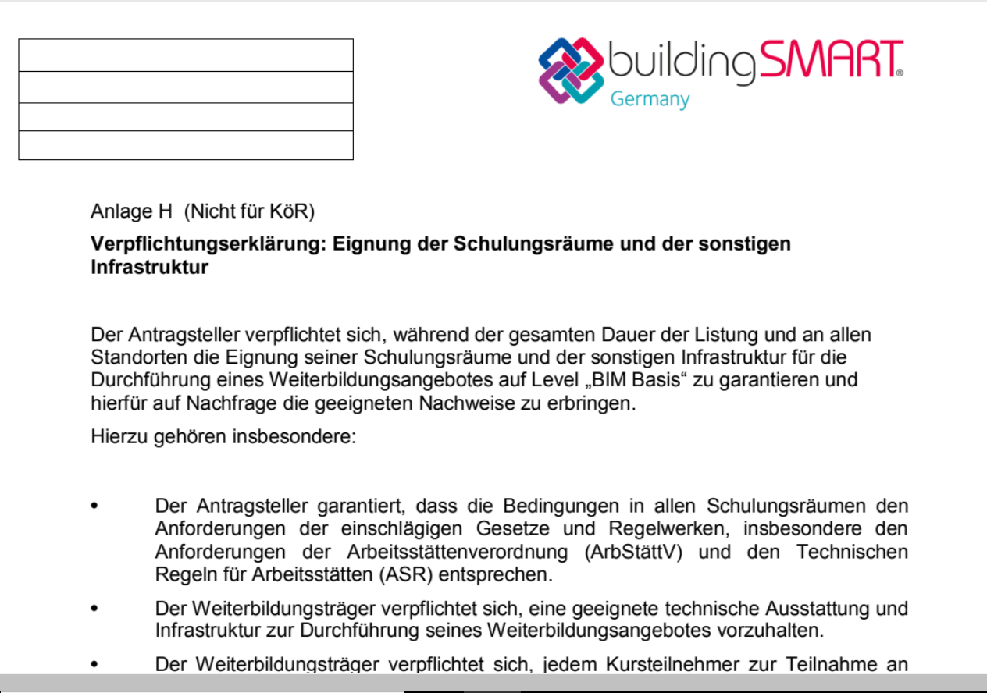
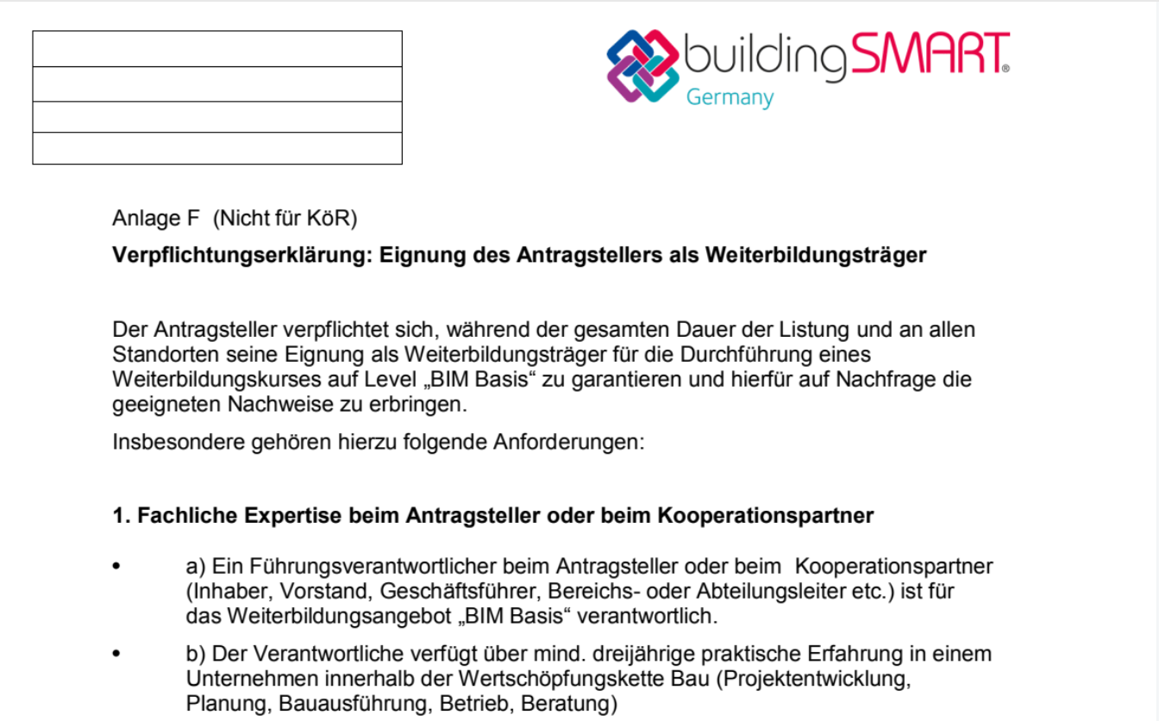
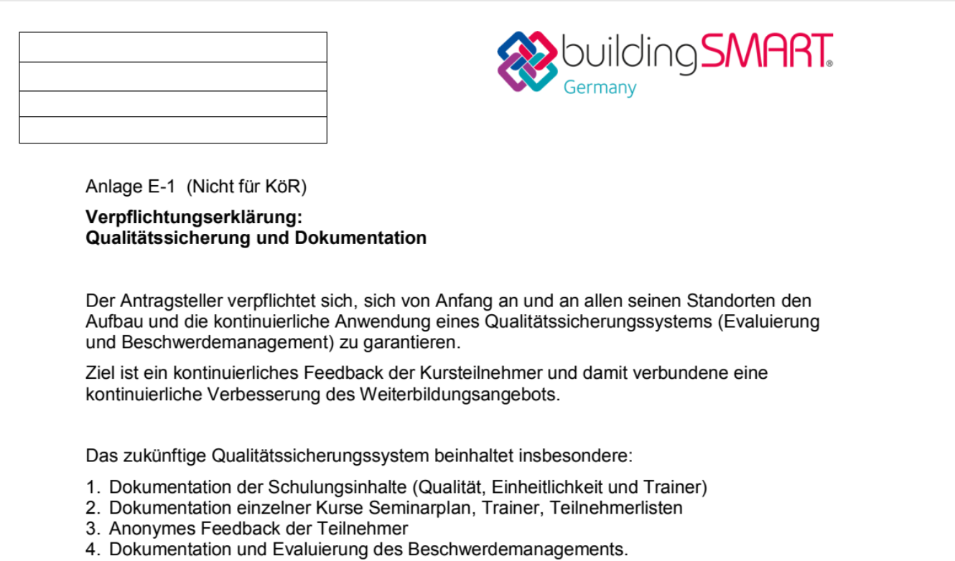
NATIONAL STANDARDIZATION
Tasks buildingSMART Chapters
Expansion of bSI LOF by national specifics and development of thereto related questions
Development of approval requirements, documents and contracts for training organizations
  Requirements on applying provider
  Requirements on trainers
  Requirements on content of teaching
  and examination
  Requirements on facilities
Notes:
Requirements on training organizations, trainers and syllabus

Slide 39

NATIONAL STANDARDIZATION
Tasks buildingSMART Chapters
Provider of online assessment tool
Provider of certificate
Contact partner for public authorities and
course providers

Slide 40
NEXT STEPS
To be excited about…
Official program launch bS Germany: April 18th, 2018
Approval of first course providers: 3rd Quarter 2018
Certification of first individuals: November 2018
Developing „Professional Knowledge“ Ongoing
✔
Professional
Certification
“applied learning“
Phase 2
Individual Qualification
“knowledge-based learning“
Min. 2 days
Phase 1

Slide 41
Thank-you
contact@buildingsmart.org
www.buildingsmart.org

